Slide 1
Presentation on Step-by-Step Guide to Installing and Configuring Ubuntu Linux Operating Systems

Slide 2
Presented By
Presented By
ID | Name | Department
22103414 | Md.Riduan Islam | BCSE
22203229 | Shuvo Chakrobortty | BCSE
Presented To
Prof. Dr. Abhijit Saha,
Department of Computer Science and Engineering

Slide 3
Contents
Downloading the Linux ISO(Ubuntu)
USB Drive(balenaEtcher) Installing
Boot from Installation Media
Disks Partitioning
Setup processing
User Account Setup
Successful Installation
Restart and Log In

Slide 4
Introduction to Ubuntu Linux
Ubuntu Linux is a powerful and versatile operating system favored by many users worldwide..
Before installation, ensure your system meets the minimum requirements for Ubuntu.
A minimum of 2 GHz dual-core processor or better, 4 GB RAM, 25 GB of free disk space.

Slide 5
Downloading Ubuntu
Visit the official Ubuntu website to download the Ubuntu 24.04.01 LTS version of the operating system.
Choose the appropriate version for our system architecture, either 64-bit or 32-bit, and ensure to verify the integrity of our download for security.
Download Link- https://releases.ubuntu.com/focal/

Slide 6
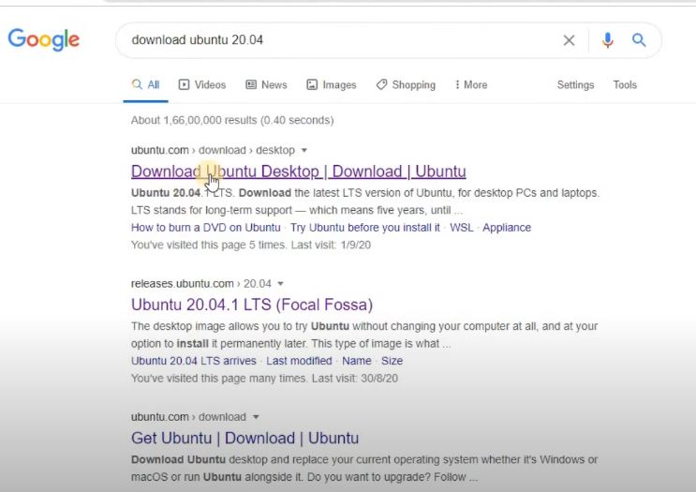
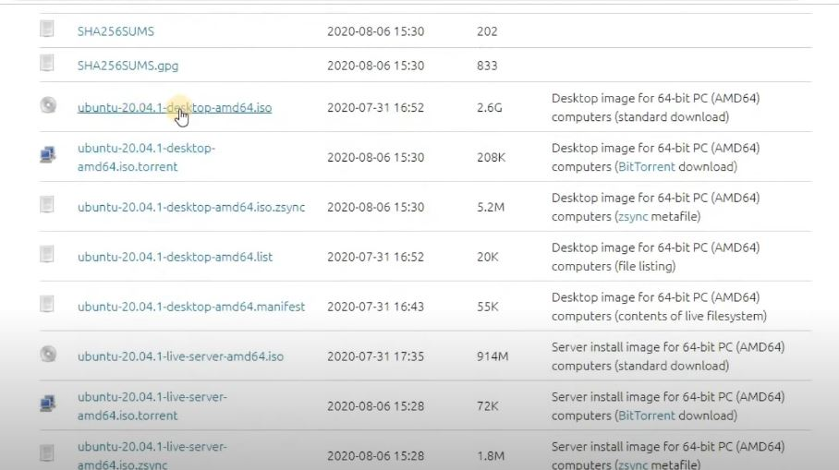
Downloading Process

Slide 7
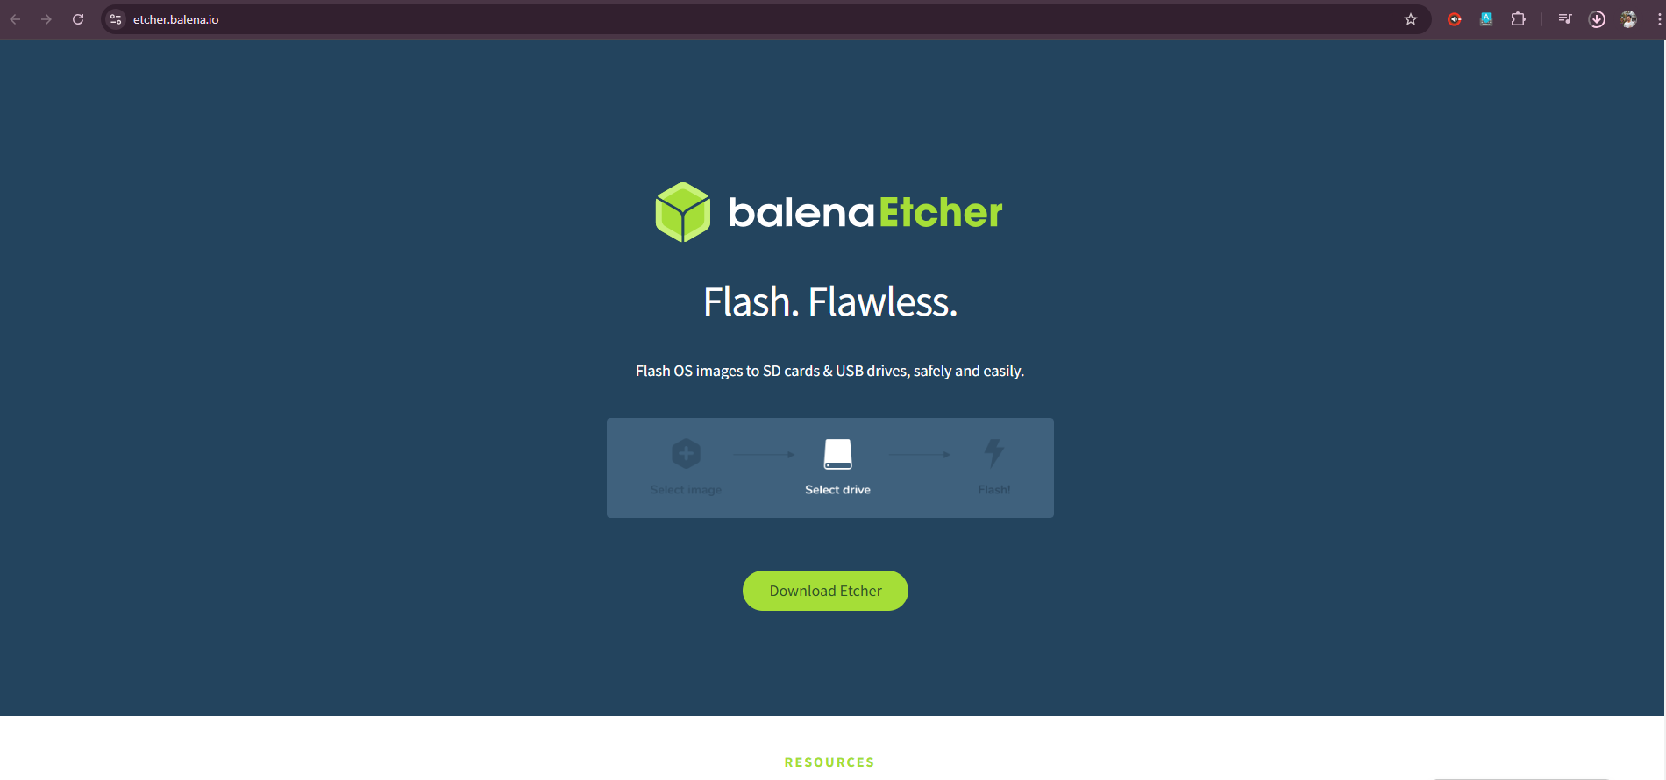
Creating a Bootable USB Drive(balenaEtcher)

Slide 8
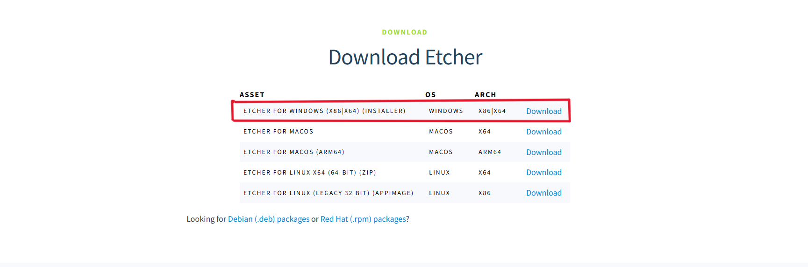
Creating a Bootable USB Drive(balenaEtcher)

Slide 9
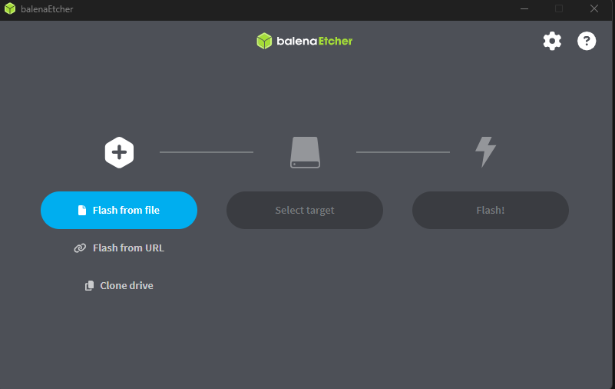
Creating a Bootable USB Drive(balenaEtcher)

Slide 10
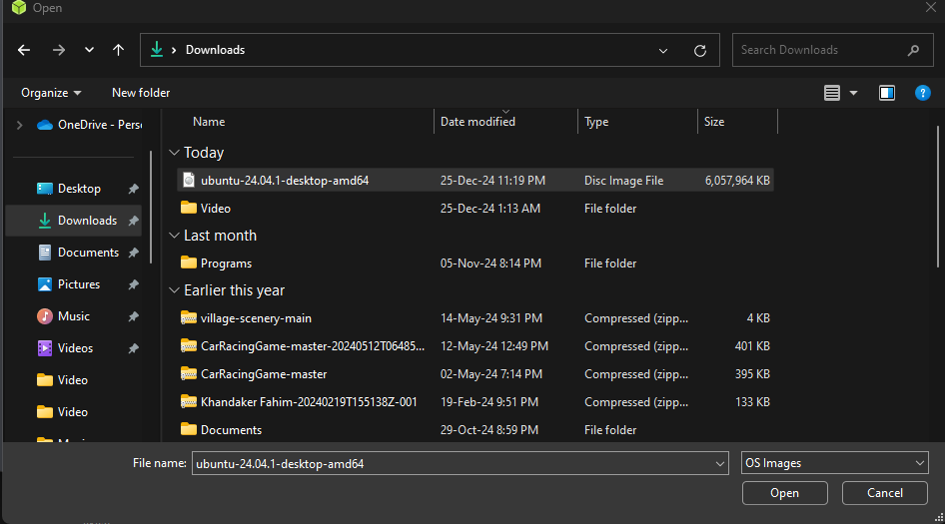
Creating a Bootable USB Drive(balenaEtcher)

Slide 11
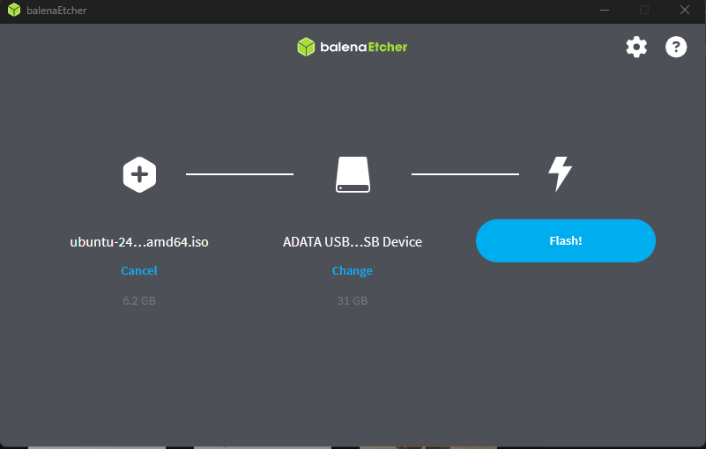
Creating a Bootable USB Drive(balenaEtcher)

Slide 12
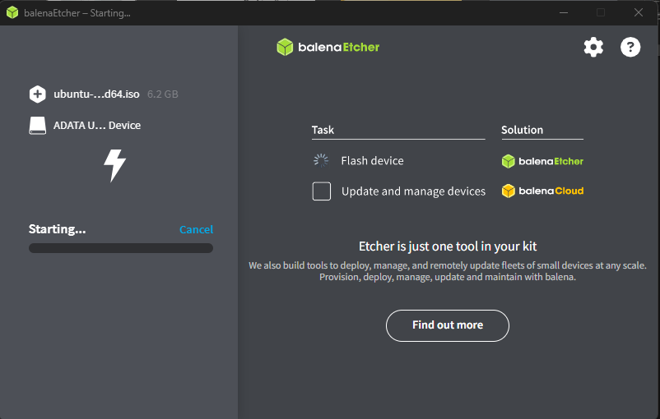
Creating a Bootable USB Drive(balenaEtcher)

Slide 13
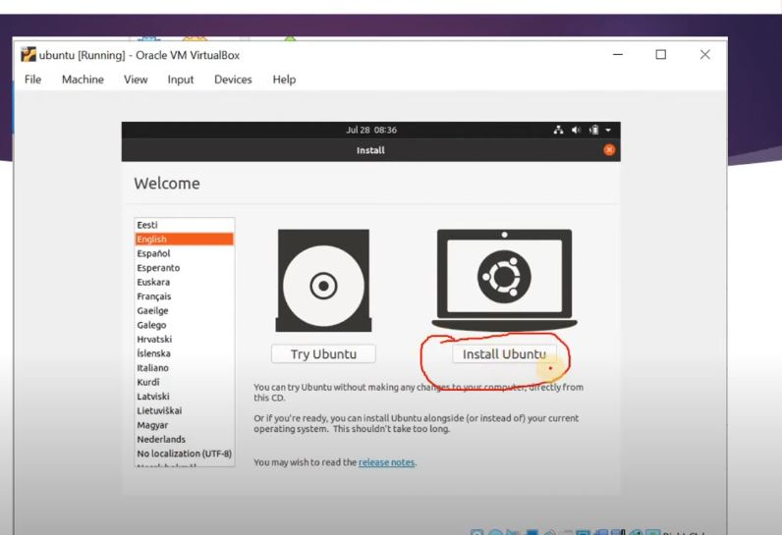
Set up Processing1
Try Ubuntu (Allows users to boot into a live session of Ubuntu without making any changes to their system. This is helpful for testing the OS before installation.)
Install Ubuntu(This option initiates the installation process of Ubuntu onto the system or virtual machine. Clicking this will take you through steps like selecting the installation type, setting up partitions, choosing a timezone, and creating user accounts.)
Select one

Slide 14
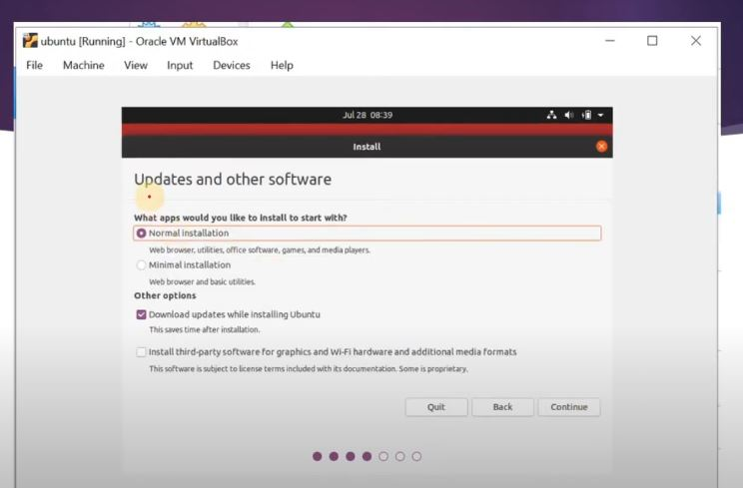
Set up Processing2(Normal Installation)

Slide 15
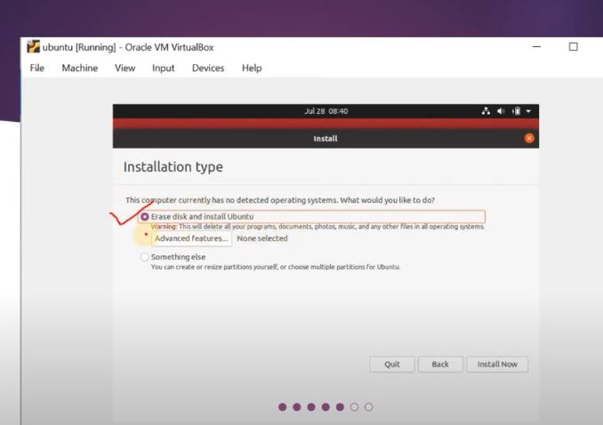
Set up Processing3

Slide 16
Erase Disk and Install Ubuntu:
This option formats the entire virtual disk and installs Ubuntu as the only operating system.
A warning is provided: "This will delete all your programs, documents, photos, music, and any other files in all operating systems."
Since this is a virtual machine, this typically applies only to the virtual hard drive created within balenaEtcher, not the host system.

Slide 17
Something Else:
This option is for advanced users who want to manually partition the disk or perform custom configurations for the installation.

Slide 18
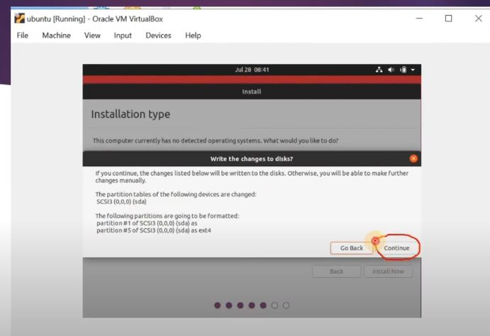
Set up Processing4(Preparing for Installation)

Slide 19
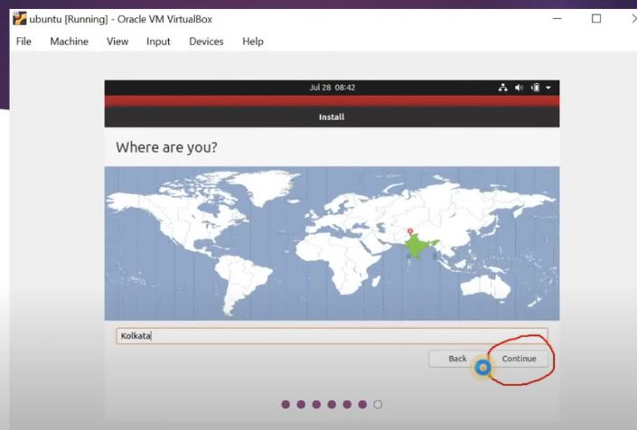
Set up Processing5(Time Zone Selection)

Slide 20
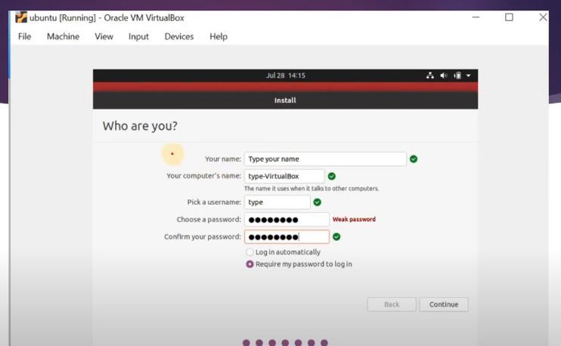
User Account Setup
This step is critical for creating a primary user account and securing the system. Once completed, the installation process moves forward to finalize the setup.
Your Name:
Your Computer's Name:
Pick a Username:
Choose a Password:
Login Options:
Fill up all this blank

Slide 21
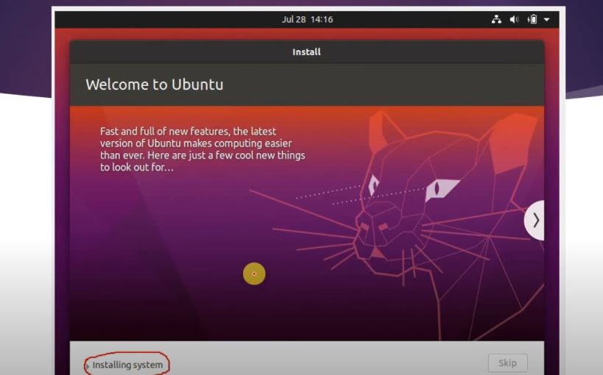
Install Successfull

Slide 22
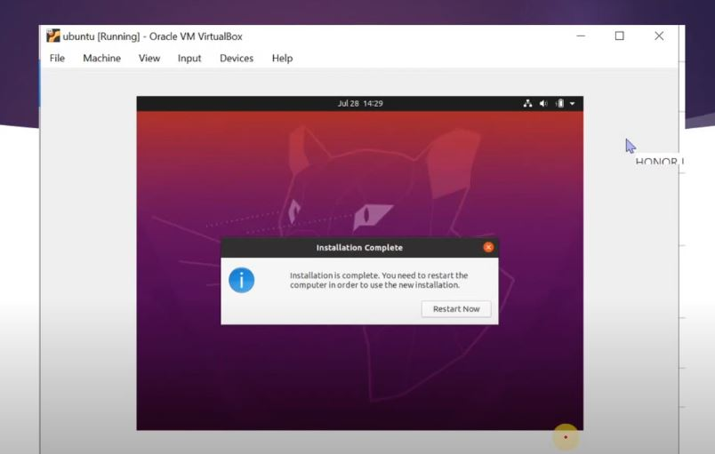
Restart and Log In(Restart)

Slide 23
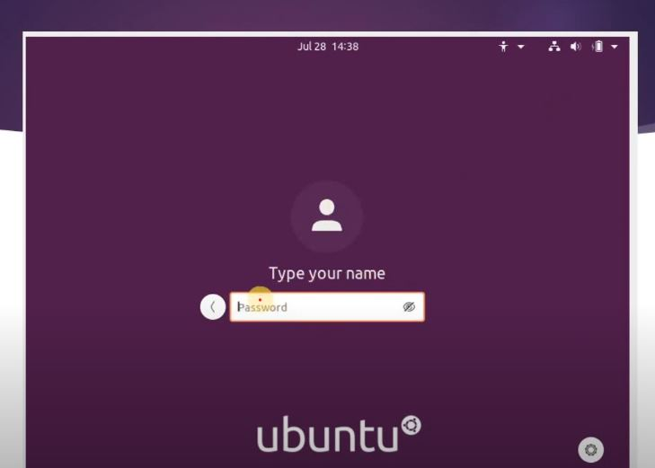
Restart and Log In(Log In)

Slide 24

Do you have any Question?

